Slide 1
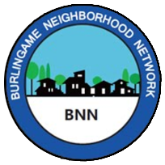
BNN Disaster Response Drill
Communications Workshop
Drill Date: October 5, 2024

Slide 2
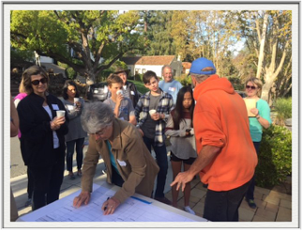
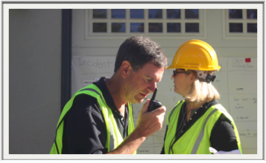
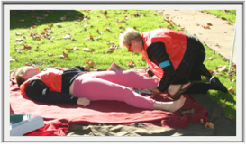
Citywide Drill Saturday, October 5, 2024
Neighborhood volunteers pull together to respond to a simulated 7.5 earthquake. Drill participants include:
• Neighborhood Block Leads
• Block volunteers
• HAM radio operators
• CERTs - Community Emergency Response Team
• Central County Fire Department (CCFD)
• Burlingame Police Department (BPD

Slide 3
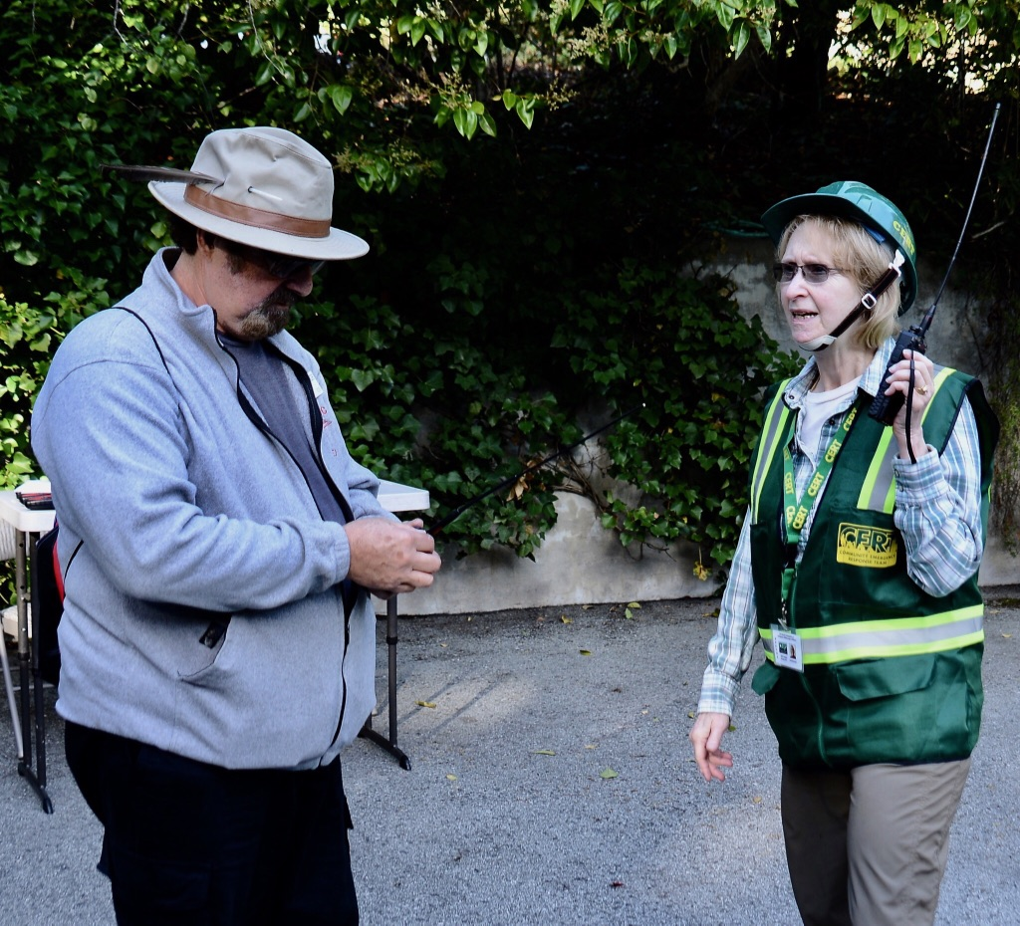
Immediate Situation
First responders may not be available to help for 72-hours or longer.
The Emergency Operations Center (EOC) may not be established for 24-hours or more.
It is up to us to help one another as best we can.
Communications is key to sharing our resources
and knowing what’s happening around us.

Slide 4
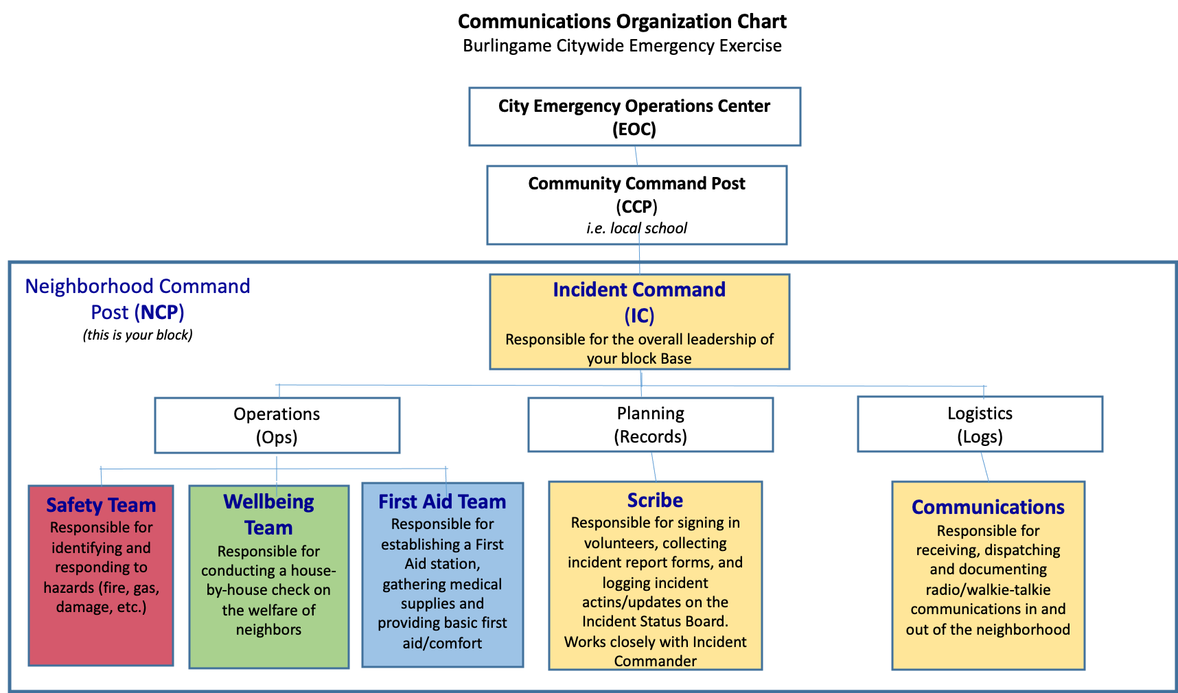
Communications Organization

Slide 5
Communications Network
Neighborhood Command Post (NCP) communications within each neighborhood and to the Community Command Post (CCP) can be facilitated using walkie-talkies, HAM radios, FRS radios, or runners.
If needed, BNN is providing each NCP with a DeWalt 2-watt FRS radio to communicate with their Community Command Post (CCP), which is located near an elementary school.
HAM radio volunteers will be positioned at CCPs to receive incident reports from NCPs and relay critical incidents to the EOC. (In an actual disaster, HAMs may relay messages between neighborhoods for resources and/or assistance).
CCPs will collect status reports to be used by the EOC to prioritize damage and response.
(In an actual disaster, for resources and/or assistance, neighborhoods may communicate with one another with FRS Radios, HAM Radios and Zello: Stay tuned!)

Slide 6
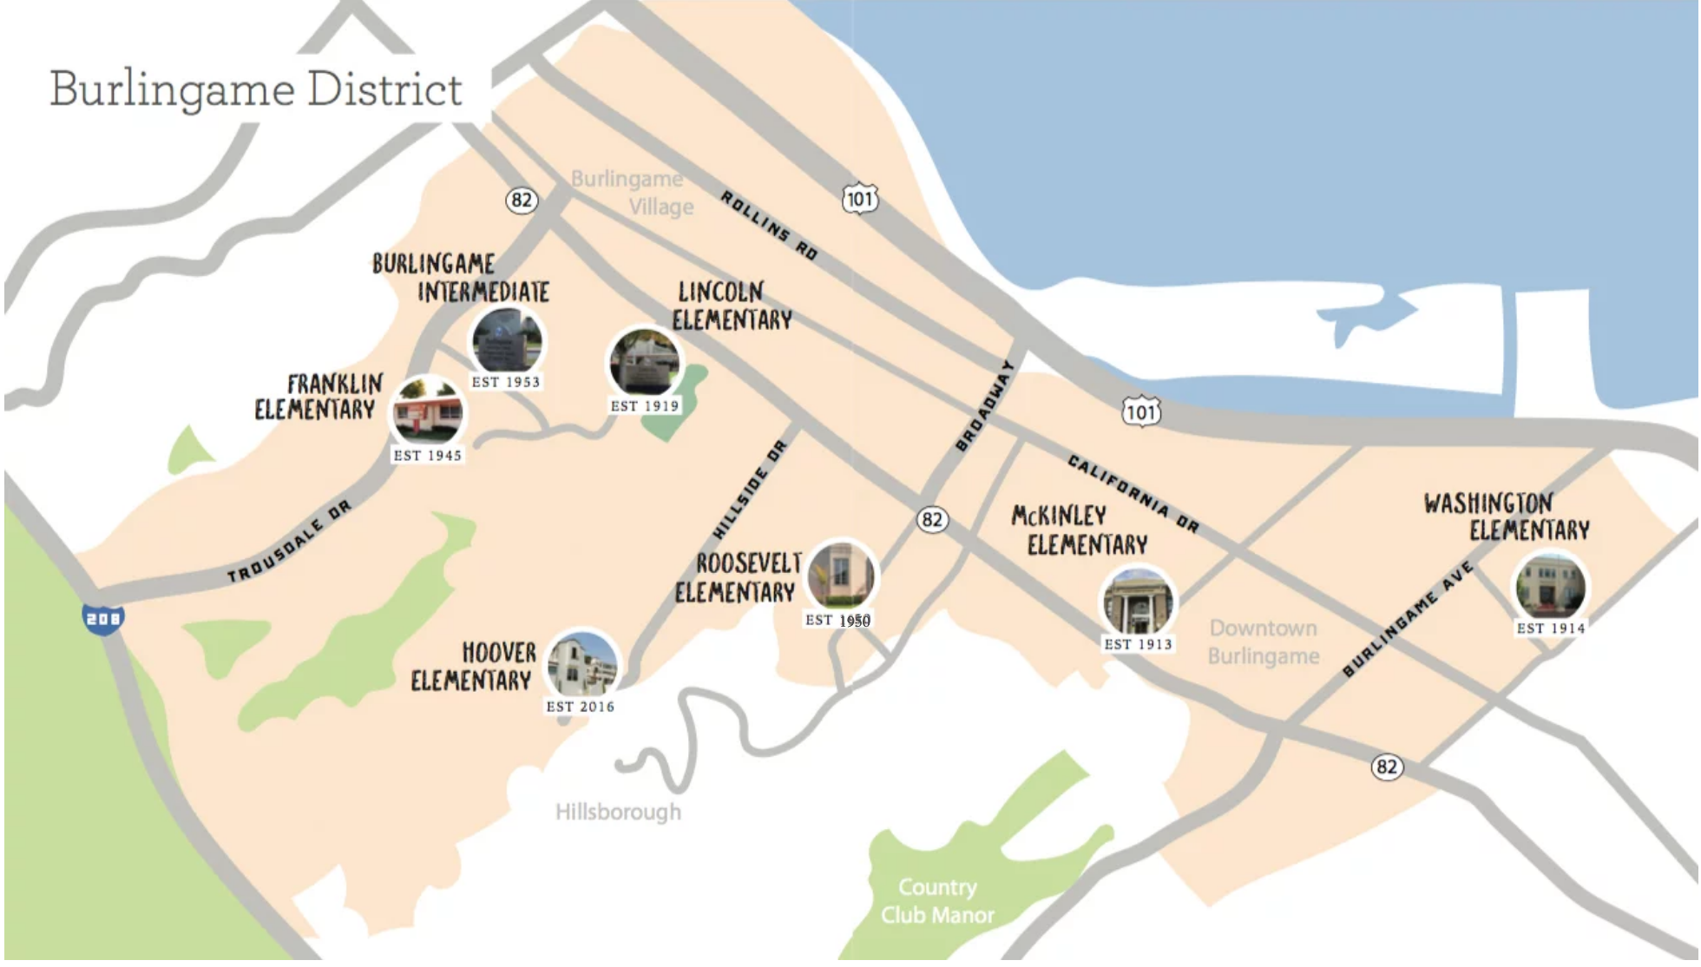
Communications Network
Burlingame Fire Station
WASHINGTON
PARK
BURLINGAME HILLS

Slide 7
How Do We Communicate?
Think about your message BEFORE using the radio. Use plain language.
Wait for a clear channel. No one can hear you if someone else is speaking
on the same channel at the same time.
RECORD this interaction on the communication log.
Say the CCP you are calling and THEN identify your NCP
(e.g. “Lincoln, this is Poppy.”)
Wait until you are acknowledged by the CCP to report your incident.
Brevity is CRITICAL. Speak about 10 words, say “Break” to pause for 2-3 seconds. If no priority traffic is heard, continue. When you are finished say “over”.
Ask for a ‘read back’ to confirm that your message has been received.

Slide 8
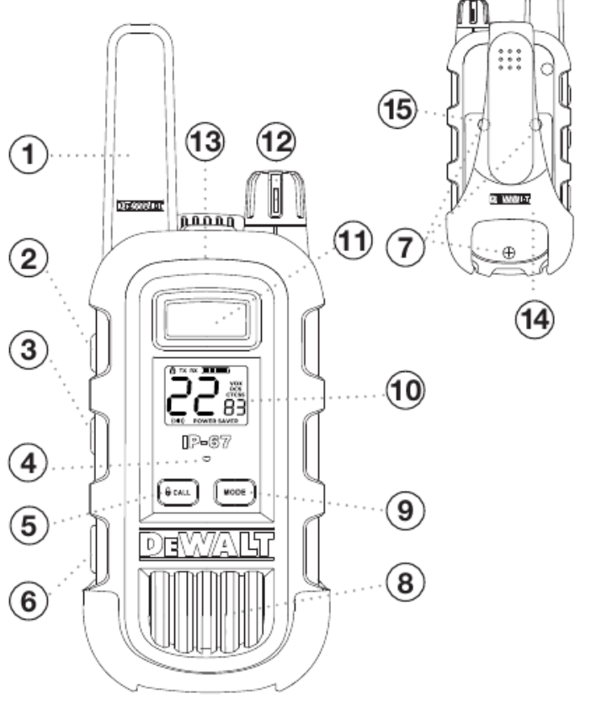
DeWalt 2-Watt Radio Operation
Antenna
Up Button
Down Button
Microphone
Call/lock Button
USB Charge Jack
Battery Door Screws
Speaker
Mode Button
Backlit LCD Display
Talk Button
Power On/Off/Volume Knob
External Speaker/Microphone Jack
Holster
Battery compartment

Slide 9
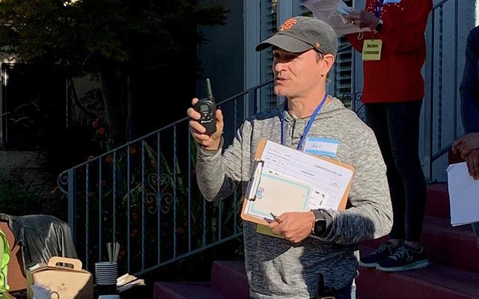
Two-Way Radio Use
Speak across the microphone
Be aware of Echo/Feedback with multiple operators
Keep antenna vertical
Improving reception
Elevation
Moving around
Rotation

Slide 10
Why Keep a Communications Log?
Multiple incidents can be confusing to track
Provides a reminder of what was communicated when
A single incident may require multiple communications
Provides a record for first responders triaging a medical or other incident
Provides a record for FEMA, insurance and other authorities about response and resolution.

Slide 11
Date ________________ Your Block ___________________________________ COMMUNICATIONS LOG
Communications Lead or HAM Radio Operator ____________________________
TIME | FROM | TO | MESSAGE SUMMARY | MODE (Radio, Zello, Text)

Slide 12
2024 Drill FRS Radio Channel, Privacy Code and HAM Simplex Assignments per Community Command Posts
CCP/Community Command Post | FRS Channel | Privacy code | HAM Simplex
Franklin School | NONE | NONE | NONE
Hoover School | 5 | 1 (DCS) | BURL 2
Lincoln School | 22 | 11 (DCS) & 31 (DCS) | BURL 2
McKinley | 7 | 22 (DCS) | BURL 1
Roosevelt | 15 | 22 (CTCSS) | BURL 1
Washington | 18 | 11 (DCS) | BURL 1

Slide 13
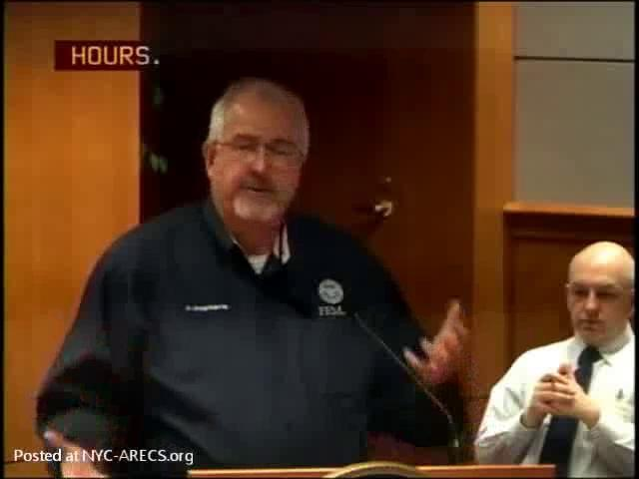
FEMA’s view on HAMs...
\

Slide 14
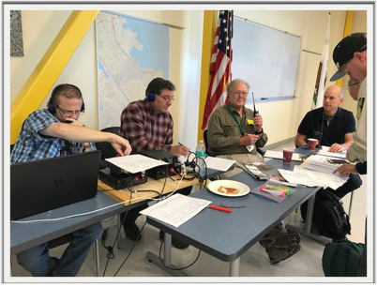
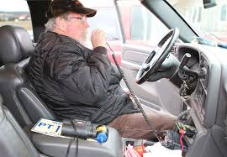
If I am a HAM and am available to help after a disaster:
How do I check in?
Burlingame V Repeater: 146.805/-600kHz/192.8 Hz
If you are first on frequency, you are Net Control. Continue to take check-ins.
Net Control can be transferred, as needed.
How do I determine if there is a need?
Monitor BURL 1 and BURL 2 (Simplex)
Monitor FRS Channel for your CCP
Zello: BNN Zello Net Channel

Slide 15
HAM Communication Plan
Ham communication to and from the EOC and the Community Command Post (CCP) will occur on Burlingame V (Repeater: 146.805/-600kHz/192.8 Hz)
NOTE: If communications are suboptimal on Burlingame V, then try Simplex using BURL 1 or BURL 2.
Ham communication to and from the CCP and the NCP will take place on Simplex BURL 1 or Simplex BURL 2.
BURL 1 (147.525/114.8 Hz) is to be used by Hams at: Washington, McKinley, and Roosevelt Schools (CCPs) and Hams in neighborhoods of those respective schools.
BURL 2 (146.595/114.8 Hz is to be used by Hams at: Franklin, Lincoln, and Hoover Schools (CCPs) and Hams in neighborhoods of those respective schools.

Slide 16
HAM Communicator Suggested Drill Schedule
Arrive at Community Command Post at 8:00 AM to 8:15 AM to set up: Locating folding table and chairs (sun), radios, antennas on mast, portable clock, communication forms that don’t fly away.
Do radio check on Burlingame V with EOC as soon as you are set up. Monitor Burlingame 1 or Burlingame 2 depending on school (CCP). Simplex may be used if Burlingame V is not optimal. (Suggest Burlingame Hills Relay do radio check with Hoover on FRS)
At around 8:50-9:00 AM, do FRS radio checks with neighborhoods.
9:00 AM Drill starts. Record all incidents received from Neighborhoods with time received. Record all incident transmissions from CCP to EOC and time sent.
By 10:30 AM all Neighborhoods should have signed out. You may sign out to the EOC when you have received all neighborhood sign outs and then secure.
Complete your Communication Log and write notes of what went well, what needs improvement and suggestions for improvement.

Slide 17
Neighborhood Communicator Suggested Schedule
Between 8:50 - 9:00 am, have 2-watt FRS radio on and ready to receive a radio check from the CCP (school) HAM.
From the start of the drill at 9:00 am, record all incidents sent to the CCP HAM with time sent on the communication log. Also record any communication from the CCP HAM with time received on the communication log.
At the completion of your neighborhood drill, notify the CCP HAM that the drill has ended in your neighborhood.
If one is unable to make contact with the CCP (school) HAM, consider asking for a RELAY from another neighborhood.

Slide 18
What Equipment Do I Need?
Neighborhood Command Post (NCP)
Neighborhoods
Intra-block Communication
Community Command Post (CCP) &
Emergency Operations Center (EOC)
2-Watt FRS Radio
HAM Radio *
Walkie Talkie
Pens/Pencils
Log Sheets
Walkie Talkies
Runners
2-Watt FRS Radio
HAM Radio
Power Source
External Antenna
Pens/Pencils
Log Sheets

Slide 19
What to Escalate During the Drill
ESCALATE HIGH PRIORITY
DO NOT RADIO LOW PRIORITY INCIDENTS
LOW Priority Incidents = Blocks will handle
HIGH Priority Incidents = Radio In
Your Block group should expect to respond to LOW and MEDIUM Priority incidents - as this Block community is doing so well here.
Most incidents are LOW / MEDIUM.
Ex: Broken arm, small fires, disoriented person.
Radio message to your volunteer HAM (at schools) any HIGH Priority incidents to escalate for emergency responders.
There will be only 1-3 HIGH incidents.
Ex: Life-threatening injury, house engulfed in fire, power lines down.

Slide 20
How would you classify these? High - Medium - Low
Chimney collapse, car damaged, dog missing
Person with broken arm
Water main broken, street is flooded
BBQ over on deck and started small fire
Downed power lines sparking, people nearby
House damaged and smell gas
House engulfed in flames and threatening other homes

Slide 21
How would you classify these? High - Medium - Low
Chimney collapse, car damaged, dog missing - Low
Person with broken arm - Medium
Water main broken, street is flooded - Medium to High
BBQ over on deck and started small fire - Low
Downed power lines sparking, people nearby - High
House damaged and smell gas - Medium
House engulfed in flames and threatening other homes - High

Slide 22
After this Evening...
Assemble all your gear
Charge your batteries
Test all your equipment
Pack your go bag:
Radios, batteries, antennas, masts/poles, paper/logs, pens/pencils, gaffers tape, manuals, cheat sheets, maps, personal protective equipment
On the morning of the drill, HAMs may be conducting radio checks with comms leads shortly before 9 a.m.

Slide 23
BNN ZELLO NET
What is Zello?
Why join the BNN Zello Net?
It enables us to practice emergency communication and resource sharing
during an emergency.
As we hold these BNN Zello Net check-ins (held at 7:30
PM on the 2nd and 4th Thursdays of each month), we become more
comfortable with the process.
Besides the BNN Zello Net channel, you can set up channels for your
neighborhood, family, other groups.
See the complete How To instructions on the BNN Website:
https://burlingamenetwork.org/resources/emergency-communications/
Contact info@burlingamenetwork.org to sign up for the BNN Zello Net channel
and receive reminders of practice sessions.

Slide 24
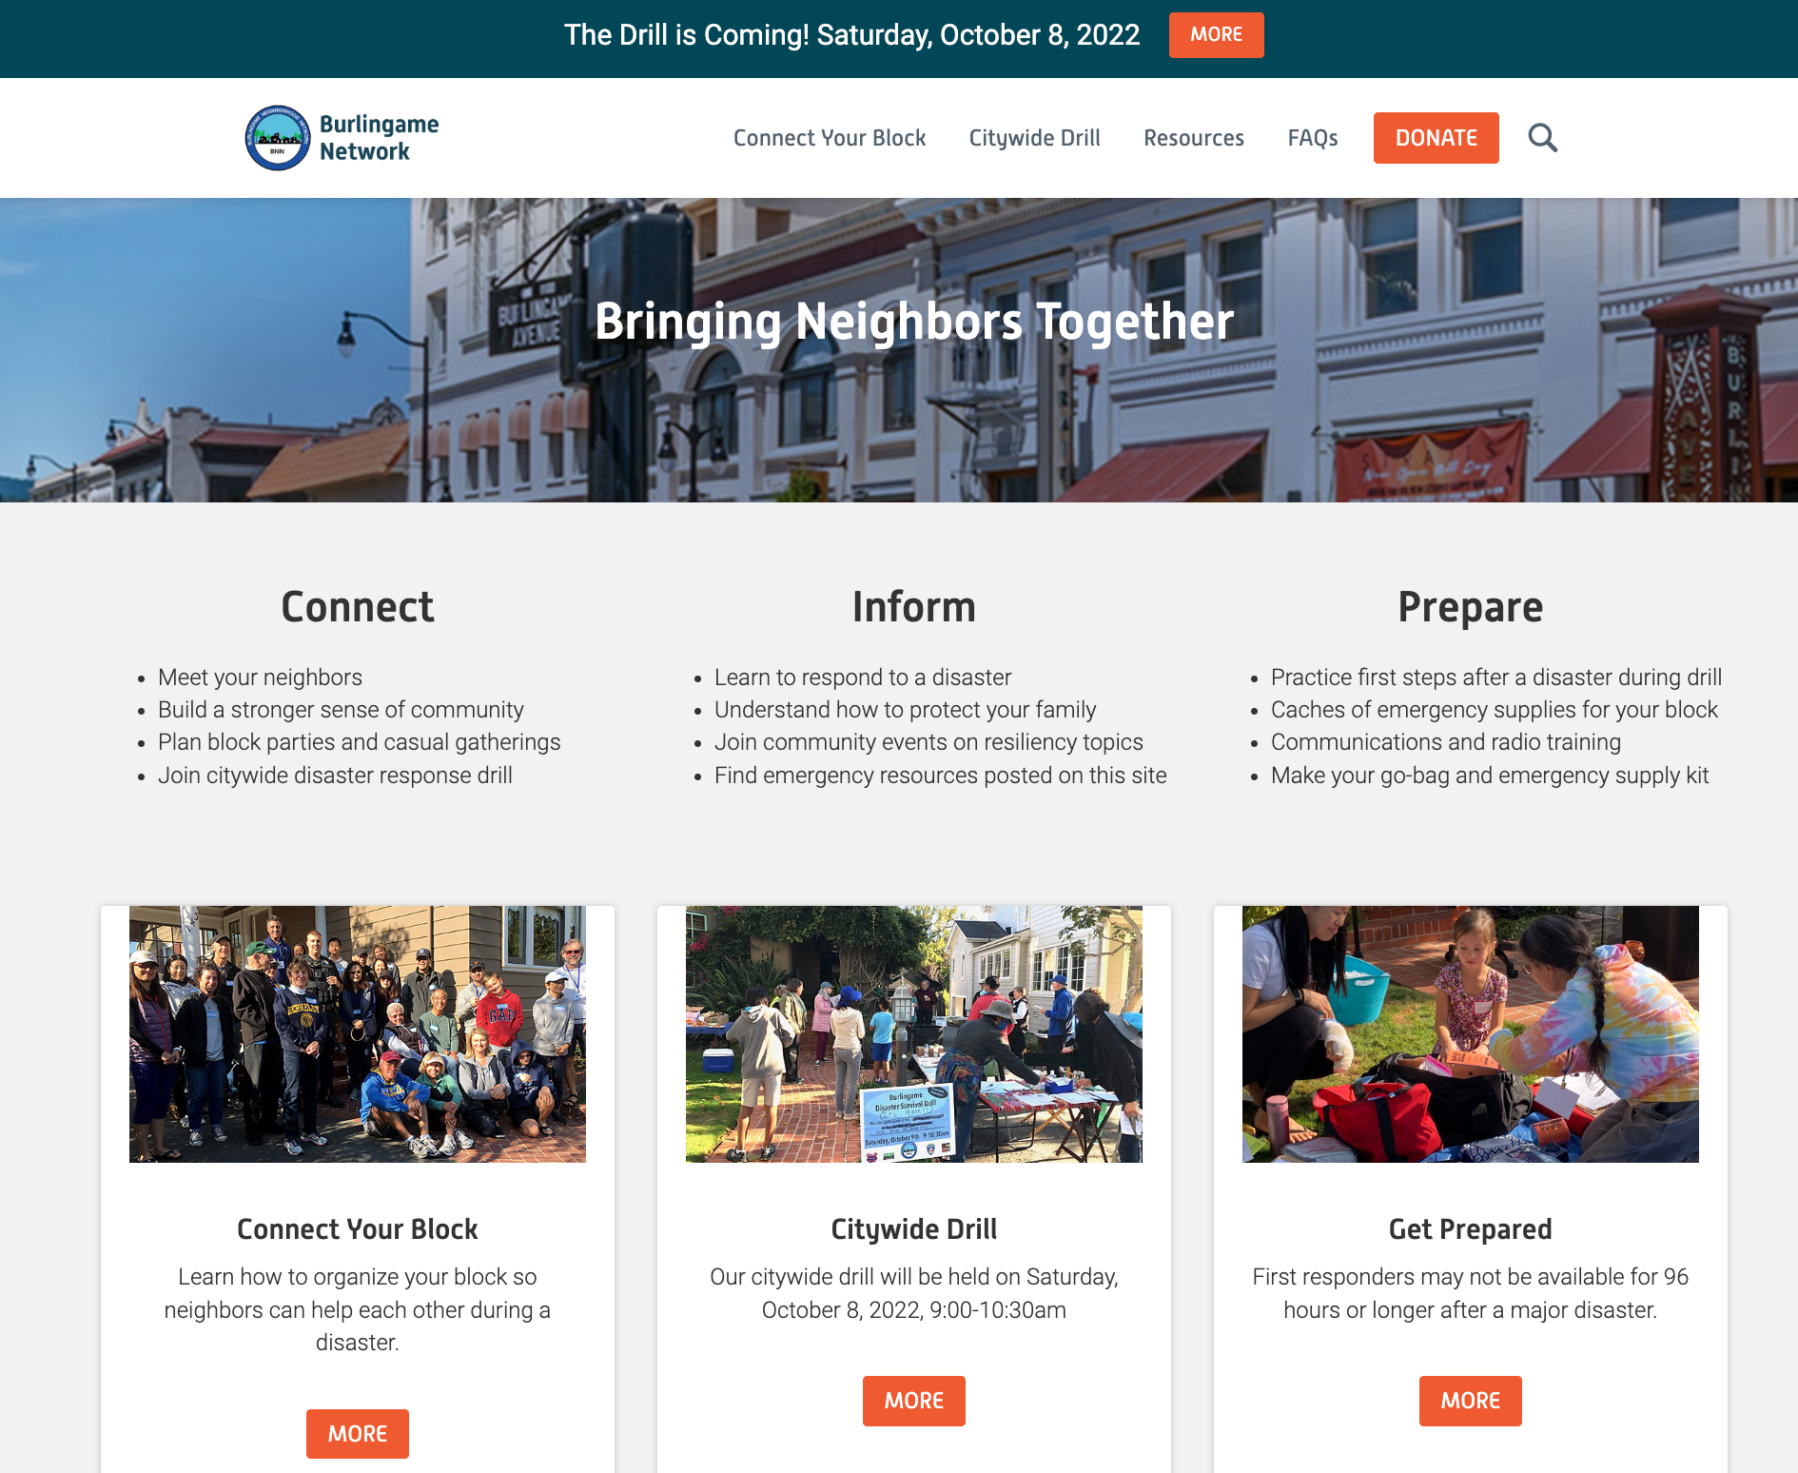
To share or review this presentation, visit our website
Burlingamenetwork.org
BurlingameNetwork.org
>Resources tab
>Drill Materials tab

Slide 25
THANK YOU for partnering with us to coordinate the communications for Burlingame’s Citywide Disaster Response Drill.
Your time and energy is appreciated. Because of your contribution, our community is more resilient!
QUESTIONS?
THANK YOU
Burlingame Neighborhood Network
and our supporting partners: Ham radio operators, Burlingame Police, Central County Fire Department and CERTs.
BNN Communications Coordinator:
Rik Kasuga
(Rik@burlingamenetwork.org)

