Slide 1
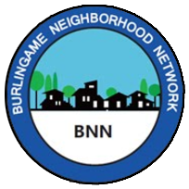
BNN Disaster Response Drill
Communications Workshop
Presenters
- Holly Daley
- Rik Kasuga
- David Harris
Drill Date: Saturday, October 8, 2022

Slide 2
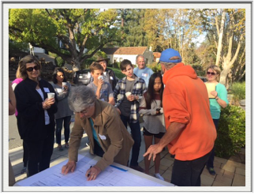
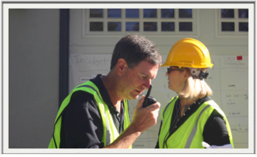
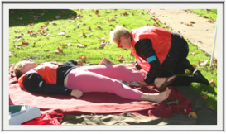
Citywide Drill Saturday, October 8, 9 – 10:30 AM
Neighborhood volunteers pull together to respond to a simulated 7.4 earthquake. Drill participants include:
• Neighborhood Block Leads
• Block volunteers
• HAM radio operators
• CERTs - Community Emergency Response Team
• Central County Fire Department (CCFD)
• Burlingame Police Department (BPD

Slide 3
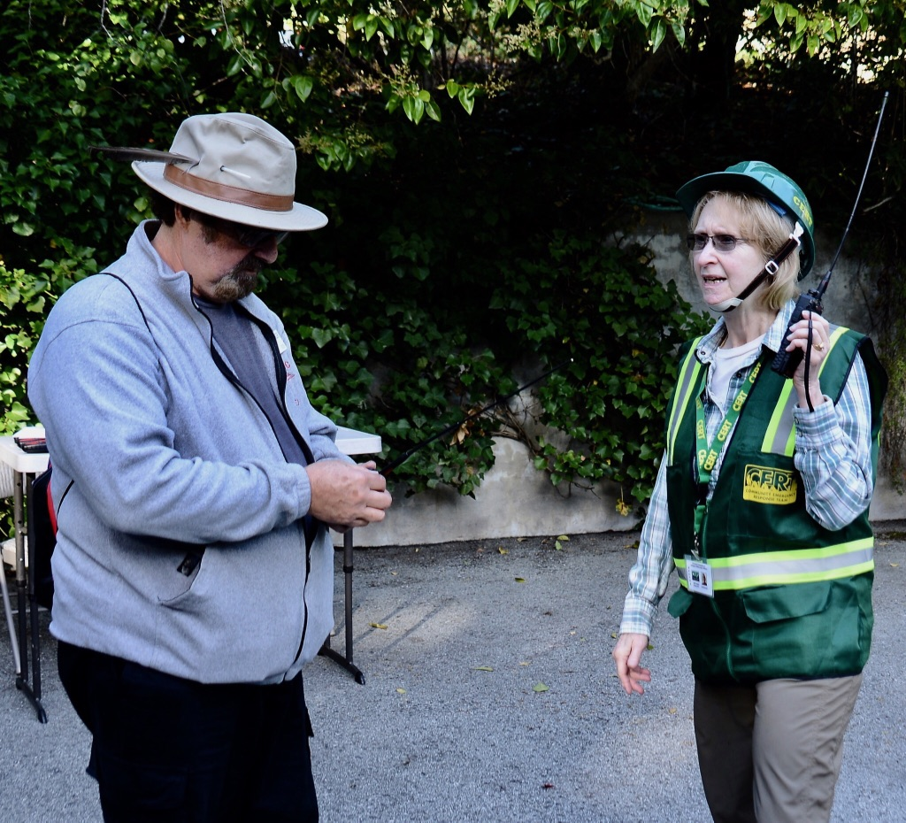
Immediate Situation
First responders may not be available to help for 72-hours or longer.
The Emergency Operations Center (EOC) may not be established for 24-hours or more.
It is up to us to help one another as best we can.
Communications is key to sharing our resources
and knowing what’s happening around us.

Slide 4
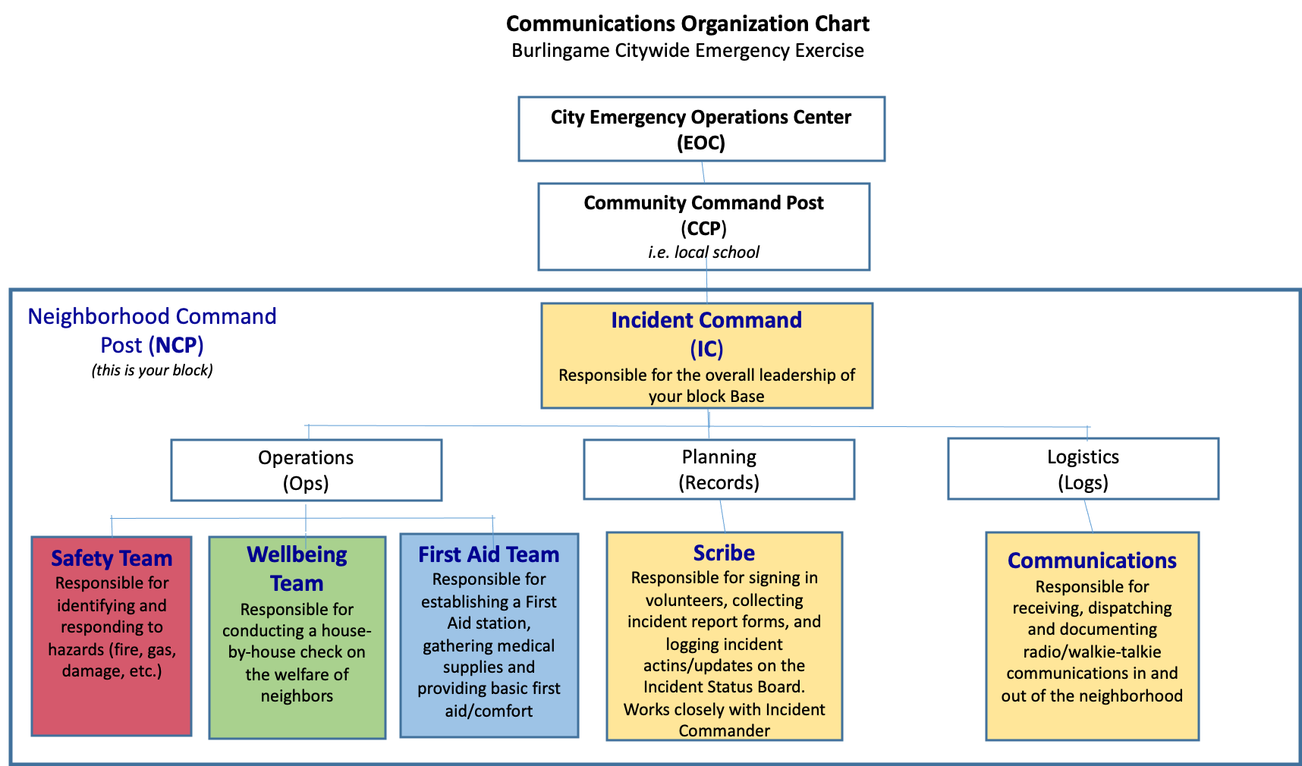
Communications Organization

Slide 5
Communications Network
Neighborhood Command Post (NCP) communications within each neighborhood and to the Community Command Post (CCP) can be facilitated using cell phones (text), walkie-talkies, HAM radios, FRS radios, or runners.
BNN is providing each NCP with a DeWalt 2-watt FRS radio to communicate with their Community Command Post (CCP), which is located near an elementary school. (DeWalt radios provided to most blocks last year)
HAM radio volunteers will be positioned at CCPs to receive incident reports from NCPs and relay critical incidents to the EOC. As needed, HAMs will relay messages between neighborhoods for resources and/or assistance.
CCPs will collect status reports to be used by the EOC to prioritize damage and response.

Slide 6
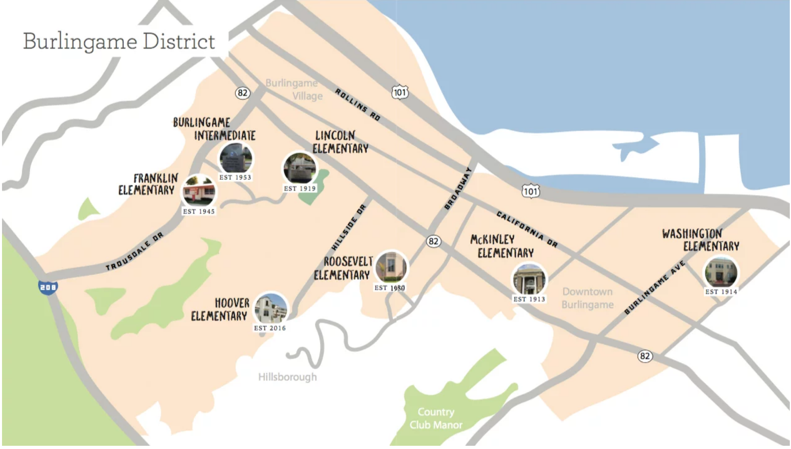
Communications Network
Burlingame Fire Station
WASHINGTON
PARK
BURLINGAME HILLS

Slide 7
NCP Communications to the CCP
What do we communicate?
For drill purposes, information to be escalated about medical emergencies, serious damage, dangerous situations.
The CCPs will collect all critical status data from each neighborhood and forward to the EOC.
The CCP may also serve as a relay between neighborhoods for acquiring tools, resources, etc. to help one another.
- Be prepared to improvise to answer any requests from NCP.

Slide 8
How Do We Communicate?
Think about your message BEFORE using the radio. Use plain language.
Wait for a clear channel. No one can hear you if someone else is speaking
on the same channel at the same time.
RECORD this interaction along with any result on the communication log.
Say the CCP you are calling and THEN identify your NCP
(e.g. “Lincoln, this is Poppy.”)
Wait until you are acknowledged by the CCP to report your incident.
Brevity is CRITICAL. Speak about 10 words, say “Break” to pause for 2-3 seconds. If no priority traffic is heard, continue. When you are finished say “over”.
Ask for a ‘read back’ to confirm that you message has been received.

Slide 9
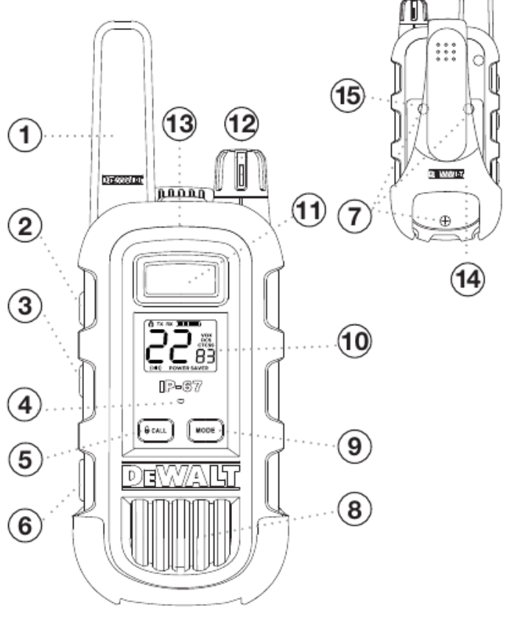
DeWalt 2-Watt Radio Operation
Antenna
Up Button
Down Button
Microphone
Call/lock Button
USB Charge Jack
Battery Door Screws
Speaker
Mode Button
Backlit LCD Display
Talk Button
Power On/Off/Volume Knob
External Speaker/Microphone Jack
Holster
Battery compartment

Slide 10
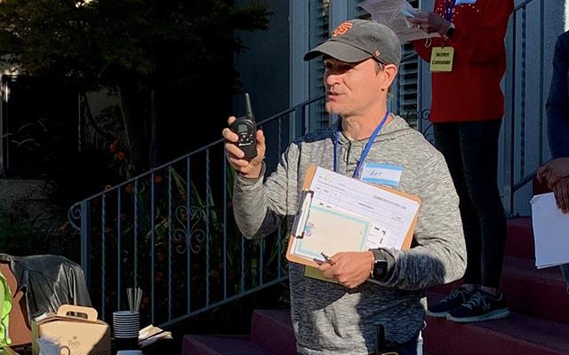
Two-Way Radio Use
Speak across the microphone
Be aware of Echo/Feedback with multiple operators
Keep antenna vertical
Improving reception
Elevation
Moving around
Rotation

Slide 11
Why Keep a Communications Log?
Multiple incidents can be confusing to track
Provides a reminder of what was communicated when
A single incident may require multiple communications
Provides a record for first responders triaging a medical or other incident
Provides a record for FEMA, insurance and other authorities about response and resolution.

Slide 12
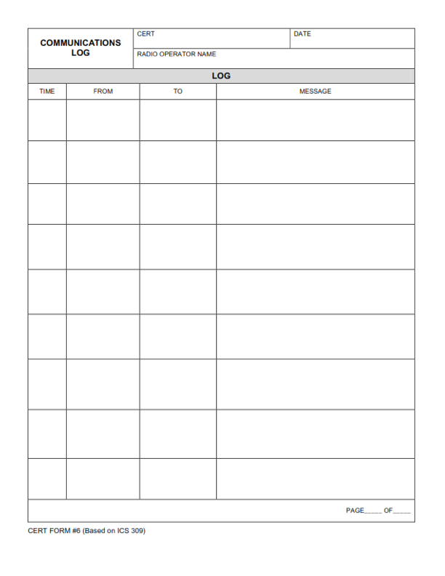

Slide 13
FRS Radio Channel Assignments
Check that the yellow DeWalt radio received last year is programmed to the correct FRS channel. If you are provided with a new one this year, it will be correctly programmed when you receive it.
School/Community Command Post | FRS Channel
Franklin | 17
Hoover | 5
Lincoln | 22
McKinley | 6
Roosevelt | 15
Washington | 18

Slide 14
HAMs: How to Check in After a Disaster
Ham communication to and from the EOC and the Community Command Post (CCP) will occur on Burlingame V (Repeater: 146.805/-600kHz/192.8 Hz)
Ham communication to and from the CCP and the NCP (for NCPs with Ham operators): These will take place on Simplex Burlingame 1 or Simplex Burlingame 2.
Burlingame 1 (147.525/114.8 Hz) is to be used by Hams at: Washington, McKinley, and Roosevelt Schools (CCPs) and Hams in neighborhoods of those respective schools.
Burlingame 2 (146.595/114.8 Hz is to be used by Hams at: Franklin, Lincoln, and Hoover Schools (CCPs) and Hams in neighborhoods of those respective schools.
NOTE: NCPs without HAM operators will use the DeWalt radios to communicate with the CCPs.

Slide 15
What Equipment Do I Need When I Check In?
Neighborhood Command Post (NCP)
Neighborhoods
Intra-block Communication
Community Command Post (CCP) &
Emergency Operations Center (EOC)
2-Watt FRS Radio
HAM Radio
Power Source
External Antenna
Pens/Pencils
Log Sheets
Walkie Talkie
Cell Phone
Runners
2-Watt FRS Radio
HAM Radio
Power Source
External Antenna
Pens/Pencils
Log Sheets

Slide 16
What to Escalate During the Drill
ESCALATE HIGH PRIORITY
DO NOT RADIO LOW PRIORITY INCIDENTS
LOW Priority Incidents = Blocks will handle
HIGH Priority Incidents = Radio In
Your Block group should expect to respond to LOW and MEDIUM Priority incidents - as this Block community is doing so well here.
Most incidents are LOW / MEDIUM.
Ex: Broken arm, small fires, disoriented person.
Radio message to your volunteer HAM (at schools) any HIGH Priority incidents to escalate for emergency responders.
There will be only 1-3 HIGH incidents.
Ex: Life-threatening injury, house engulfed in fire, power lines down.

Slide 17
How would you classify these? High - Medium - Low
Chimney collapse, car damaged, dog missing
Person with broken arm
Water main broken, street is flooded
BBQ over on deck and started small fire
Downed power lines sparking, people nearby
House damaged and smell gas
House engulfed in flames and threatening other homes

Slide 18
How would you classify these? High - Medium - Low
Chimney collapse, car damaged, dog missing - Low
Person with broken arm - Medium
Water main broken, street is flooded - Medium
BBQ over on deck and started small fire - Low
Downed power lines sparking, people nearby - High
House damaged and smell gas - Medium
House engulfed in flames and threatening other homes - High

Slide 19
After this Evening...
Assemble all your gear
Charge your batteries
Test all your equipment
Pack your go bag:
Radios, batteries, antennas, masts/poles, paper/logs, pens/pencils, gaffers tape, manuals, cheat sheets, maps
On the morning of the drill, HAMs may be conducting radio checks with comms leads shortly after 9 a.m.

Slide 20
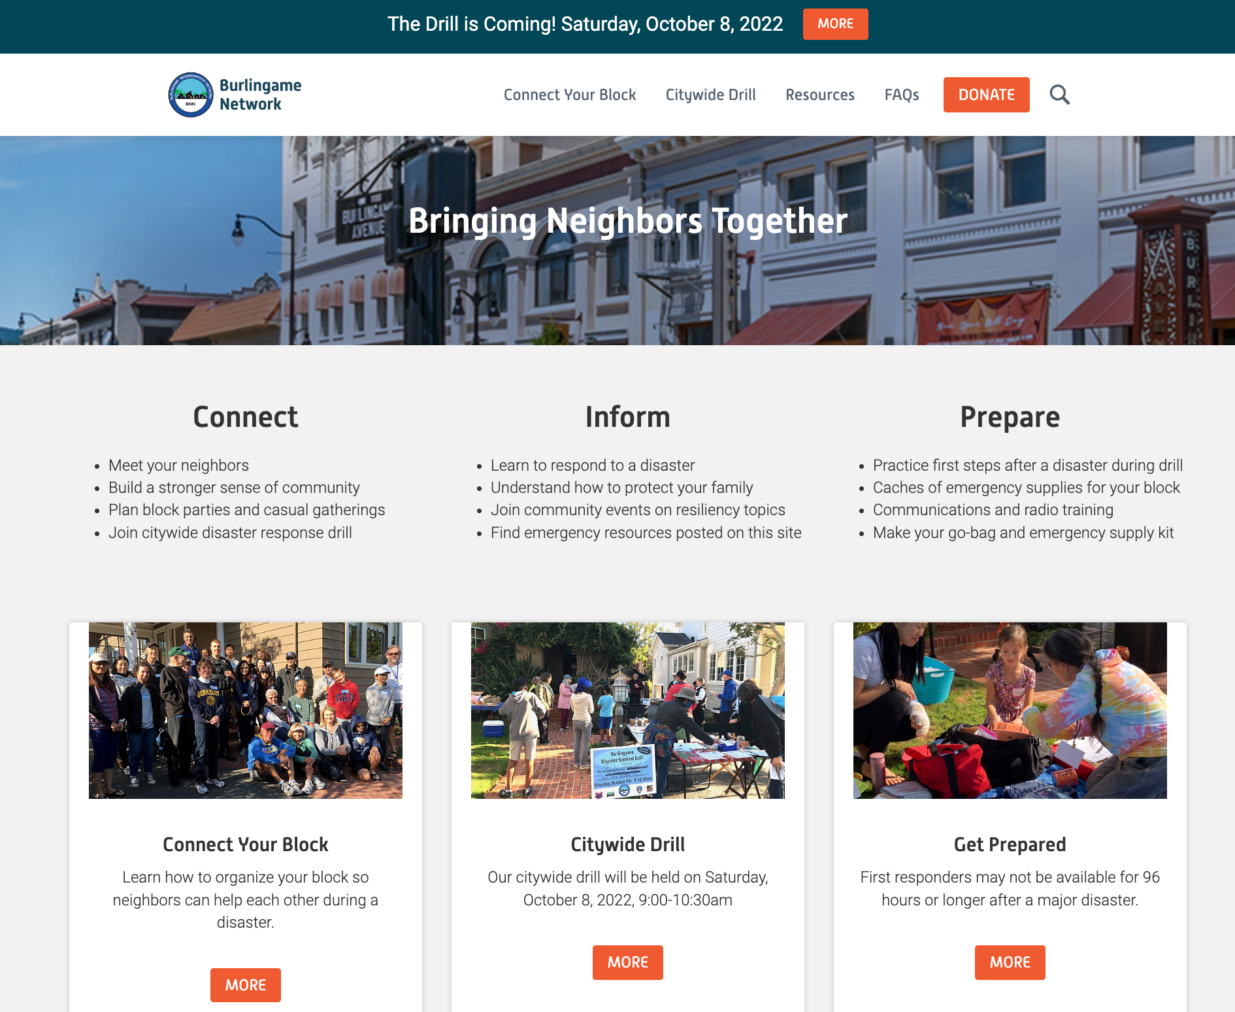
To share or review this presentation, visit our website
Burlingamenetwork.org
BurlingameNetwork.org
>Resources tab
>Drill Materials tab
> Drill Lead Resources

Slide 21
THANK YOU for partnering with us to coordinate the communications for Burlingame’s Citywide Disaster Response Drill.
Your time and energy is appreciated. Because of your contribution, our community is more resilient!
QUESTIONS?
THANK YOU
Burlingame Neighborhood Network
and our supporting partners: Ham radio operators, Burlingame Police, Central County Fire Department and CERTs.
BNN Communications Team
Rik Kasuga
(Rik@burlingamenetwork.org)
David Harris (dharris@burlingamenetwork.org)

